Slide 1
Haciendo tuya la Visión
Notes:
Own the Vision - 50 Minutes
YOU NEED:
A Power Point slide with a personal photo
Notebook p 3-8
Planner p 3-5

Slide 2
¿Por qué necesitamos hacer el discipulado de nuestros hijos una prioridad AHORA?
51% +
Notes:
WHAT & HOW – 35 minutes
• Participants turn to Notebook p 4 to start taking notes.
Ask the participants if they can guess what the number represents?
Current research from Value Genesis and Dr. Roger Dudley (Why Our Teenagers Leave the Church) reveals that the SDA church in North America is losing more than 50% of our Adventist young people by the time they reach their 20’s. (Give statistics for your own country/world area if you have them).

Slide 3
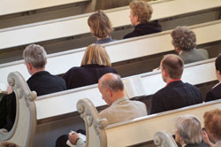
¿Por qué necesitamos hacer el discipulado de nuestros hijos una prioridad AHORA?
36 / 52
Notes:
36 is the median age of the population of the United States
52 is the median age of the population of the Seventh-day Adventist Church
INNOVATION (Center for Creative Ministry) Volume 12, Number 19, November 1, 2006.

Slide 4
¿Por qué necesitamos hacer el discipulado de nuestros hijos una prioridad AHORA?
0-13
Notes:
According to research by George Barna, the “magic” window to secure decisions for Jesus Christ is from birth – 13. Considering the entire range of a person’s life, he/she is most open to accepting Jesus during this narrow age range.
Transforming Children into Spiritual Champions by George Barna, pages 18, 24, 47.

Slide 5
¿Qué falta?
Notes:
Our children are missing
a personal relationship with Jesus Christ
missing having the assurance of salvation
missing daily time alone with God
missing a Biblical foundation for their faith
missing the joy of using their gifts in worship, ministry, and mission
missing the joy of discipling their friends to Jesus

Slide 6
¡Dios tiene sueños para Sus hijos!
Notes:
God has revealed His dreams for our children in His Word.

Slide 7
¿Cuáles son los sueños de Dios para los niños?
Hechos 2: 17
“Y en los postreros días, dice Dios, Derramaré
de mi Espíritu sobre toda carne, Y vuestros hijos y vuestras hijas profetizarán; Vuestros jóvenes verán visiones, Y vuestros
ancianos soñarán sueños.”
Notes:
Invite participants to read Acts 2:17 in unison. Point out that Peter is quoting Joel 2.
Ask: “What is God’s dream for children?”
Filled with the Holy Spirit
Prophesying
Dreaming dreams with adults who have visions

Slide 8
¿Cuáles son los sueños de Dios para los niños?
Malaquías 4:5,6
“He aquí, yo os envío el profeta Elías… El hará volver el corazón de los padres hacia los hijos, y el corazón de los hijos hacia los padres …”
Notes:
Invite participants to read Malachi 4:5, 6 in unison.
Ask: “What is God’s dream for children?”
They have fathers and mothers whose hearts are drawn to them
Their hearts are drawn to their parents

Slide 9
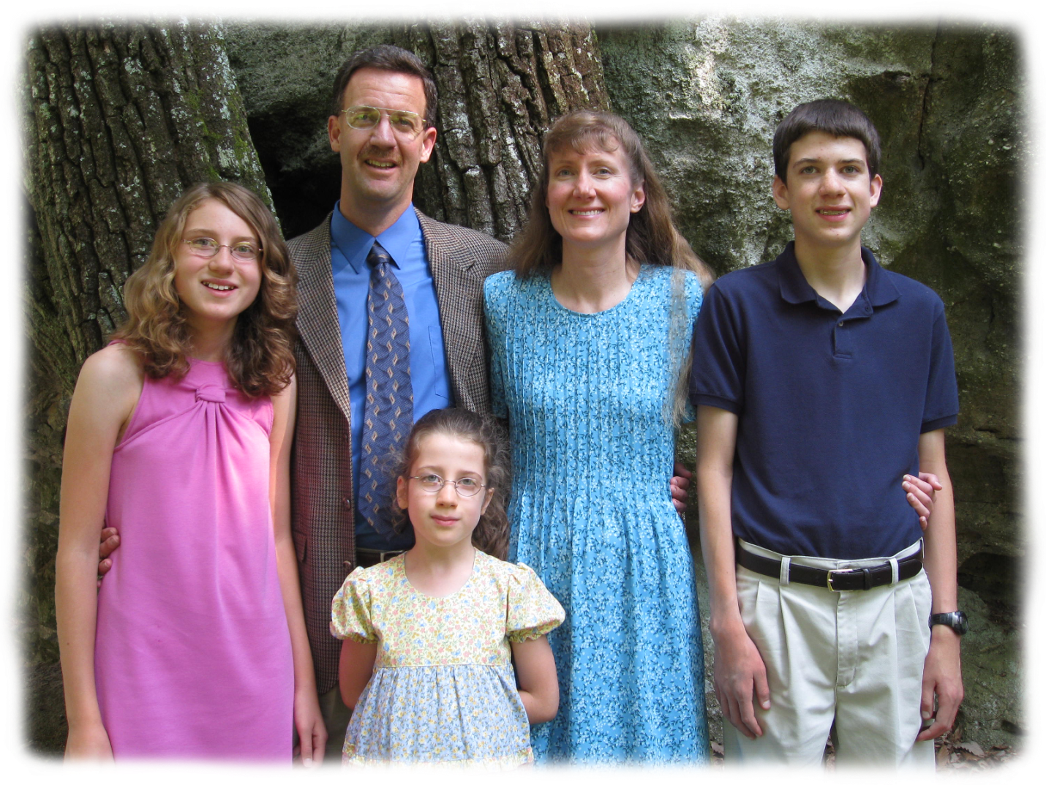
La Familia MacLafferty
Notes:
Briefly tell Pastor Don MacLafferty’s story: At this time in his ministry, Don was not investing one-on-one time with his children. His life was focused on what God was doing in the church rather than what God was yearning to do in his home.
young successful pastor in church building project
wintry night – came home for supper then off to building committee meeting
said “Bye!” – Julie and Jason (ages 3 and 7) cried, “Daddy, stay home with us.”
“Can’t stay. Made a promise. Gotta go.”
They clung to Don’s neck, crying, “Daddy, you never play with us.”
Don pried their little fingers from his neck, felt no remorse, said goodbye and left.
Walking across the road to the church God got through to him.
Stood in the middle of the street, looking back and forth from the lighted church to his home.
God said, “When I come, I won’t ask you about the new church you built. I won’t ask you how many members joined your church. I will ask you “Where are Julie and Jason?”
God called this Daddy’s heart back to his children.
This experience sent Don on a journey to seek God’s will.
Don discovered God’s dreams for his own children and for all the children in His care.
The vision for Kids in Discipleship was clear to him --Need to call the hearts of parents back to their children --Need to equip parents to be the primary spiritual mentor of their own children to fulfill God’s dreams for them.
Consider putting in a picture of your own and personalizing the K.I.D. Vision as it relates to your and your children.

Slide 10
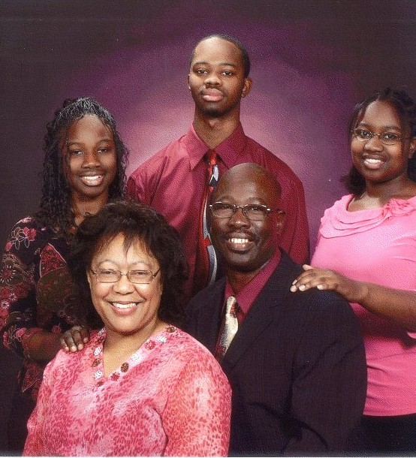
La Familia Carter
Notes:
Briefly tell Pastor Don MacLafferty’s story: At this time in his ministry, Don was not investing one-on-one time with his children. His life was focused on what God was doing in the church rather than what God was yearning to do in his home.
young successful pastor in church building project
wintry night – came home for supper then off to building committee meeting
said “Bye!” – Julie and Jason (ages 3 and 7) cried, “Daddy, stay home with us.”
“Can’t stay. Made a promise. Gotta go.”
They clung to Don’s neck, crying, “Daddy, you never play with us.”
Don pried their little fingers from his neck, felt no remorse, said goodbye and left.
Walking across the road to the church God got through to him.
Stood in the middle of the street, looking back and forth from the lighted church to his home.
God said, “When I come, I won’t ask you about the new church you built. I won’t ask you how many members joined your church. I will ask you “Where are Julie and Jason?”
God called this Daddy’s heart back to his children.
This experience sent Don on a journey to seek God’s will.
Don discovered God’s dreams for his own children and for all the children in His care.
The vision for Kids in Discipleship was clear to him --Need to call the hearts of parents back to their children --Need to equip parents to be the primary spiritual mentor of their own children to fulfill God’s dreams for them.
Consider putting in a picture of your own and personalizing the K.I.D. Vision as it relates to your and your children.

Slide 11
¿Cuáles son los sueños de Dios para los niños?
Deuteronomio 6:4-7
Oye, Israel: Jehová nuestro Dios, Jehová uno es.
Y Amarás á Jehová tu Dios de todo tu corazón, y de toda tu alma, y con todo tu poder.
Y estas palabras que yo te mando hoy, estarán sobre tu corazón.
Y las repetirás á tus hijos, y hablarás de ellas estando en tu casa, y andando por el camino, y al acostarte, y cuando te levantes.
Notes:
Invite a volunteer to read Deuteronomy 6:4-7.
Ask: “What is God’s dream for children?”
Spiritually mentored by their parents
Love the Lord with all their hearts
Obey God’s commandments

Slide 12
¿ A quién ha llamado Dios para ser los principales discípulos de los niños?
LOS PADRES
Notes:
How do we know that God’s plan is for parents to mentor their children?
The Deuteronomy Model says, “when you sit at home, when you walk along the way, when you lie down, when you get up.”

Slide 13
La Visión de K.I.D. :
Cada niño es un discípulo de Jesuscristo!
Notes:
God’s dream is that our children be empowered disciples of His now, not at some future time. Kids in Discipleship is a ministry offered in local churches specially designed for families and focused on children. It is a means to facilitate God’s dreams for His children.
A local K.I.D. Ministry is a tool for churches to use to be intentional about discipleship. This ministry is a local church will equip parents to disciple their own children, to ground their children in a relationship with Jesus Christ, to empower families to participate in their local church in worship, in ministry to other believers, and in mission to others outside our faith.

Slide 14
¿Cómo poner K.I.D en práctica
en tu iglesia?
ORACION
Preparar a la iglesia
Equipar a los padres
Hacer discípulos de
los Niños
Notes:
How do churches start a K.I.D. ministry for the families and children of their congregation?
Churches begin by establishing a prayer ministry with a prayer coordinator who recruits other prayer partners to seek God’s will for the families and children of their local congregation. We can’t overestimate the value of prayer. Without this connection the Holy Spirit is not empowered, and it is the Holy Spirit who turns the hearts of parents to their children and children to their parents.
Second, church teams attend a K.I.D. University. They return home to prepare their church to receive and support this discipleship ministry.
The next step is to equip the parents to be disciple makers. Parents and other mentors learn to go deeper in their relationship with Jesus in their own discipleship experience. Then they learn how to be intentional in mentoring their children.
Lastly the children (together with their parents/mentors) are discipled to Jesus. They grow into a deeper relationship with Jesus. They learn how to have their own time alone with God. They learn the truths of Jesus as found in His Word. They learn how to share Jesus with others.

Slide 15
ORACION
Prepara a la iglesia
Equipar a los padres
Hacer discípulos de
los Niños
RESULTADOS
Hacer discípulos de los padres y mentores.
Hacer discípulos de los niños.
Familias con la capacidad de hacer discípulos de otros.
Notes:
What are the results for parents & mentors?
They rediscover Jesus call to discipleship.
They intentionally mentor their own children.
They don’t need to depend upon anyone else to connect their children to Jesus. (Tell a story here)
What are the results for families?
Family relationships are strengthened.
Spiritual communication is increased and “natural.”
They experience together a deeper involvement in the life of the church in worship and ministry and mission. (Tell a story here)
What are the results for children?
Children establish a personal connection to Jesus in daily time alone with Him. (Carina)
Children understand the Biblical foundation for their Christian beliefs.
Children experience the joy of bringing their friends to Jesus. (Pernille)

Slide 16
ORACION
Entrenar Misioneros
Construir puentes para los vecinos
Hacer discípulos de los niños
RESULTADOS

Slide 18
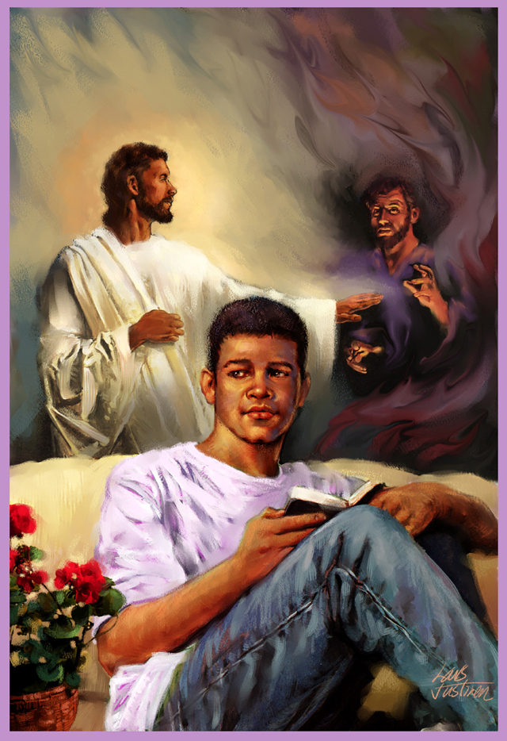

Slide 19
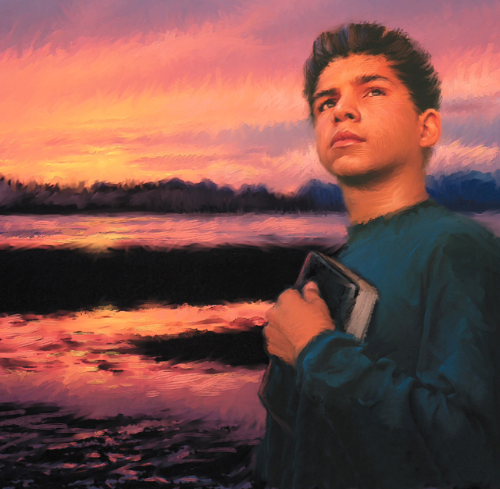

Slide 20
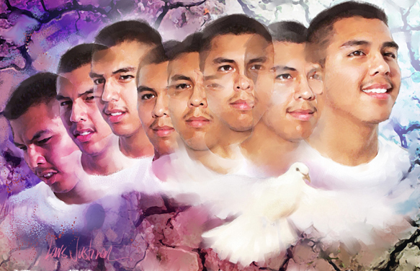

Slide 21
¿Qué pasaría si
SU IGLESIA pusiera en práctica el Ministerio K.I.D.?
Notes:
IF – 10 minutes
TEAM TIME: Teams discuss the following: (KID Planner p 3 – 5)
If a family in your church went through a life-transforming discipleship journey with Jesus how would it affect their home?
How might KID ministry affect your church?
How might it affect the spiritual lives of the church members?
Invite 1 – 2 comments. Give the participants time to pair/share their answer to this questions.
• Invite comments and questions.

